Slide 1
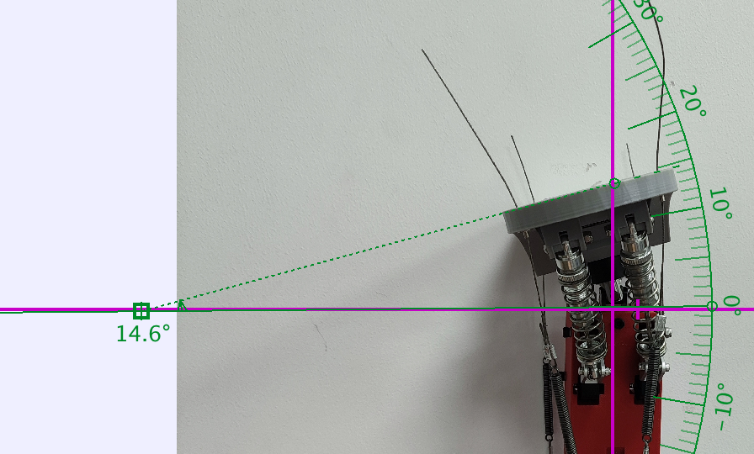
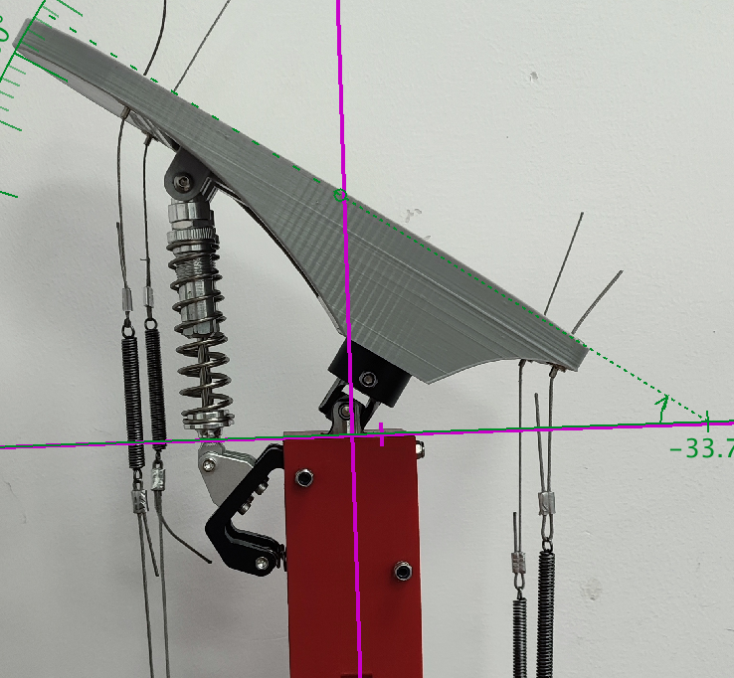
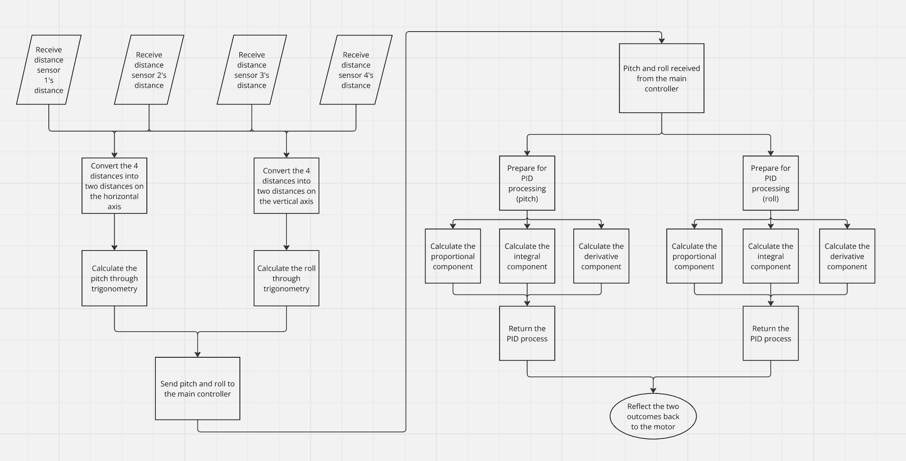
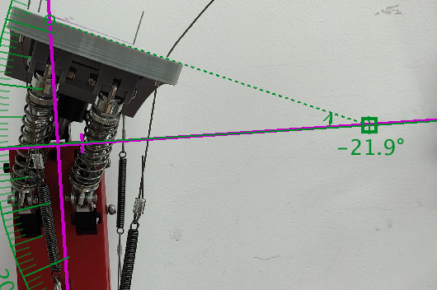
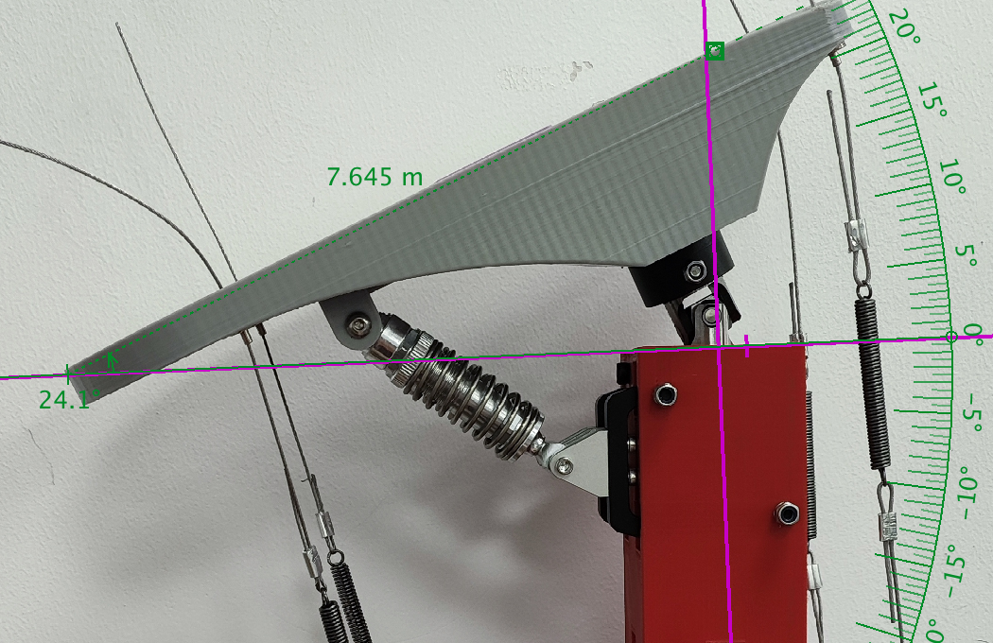
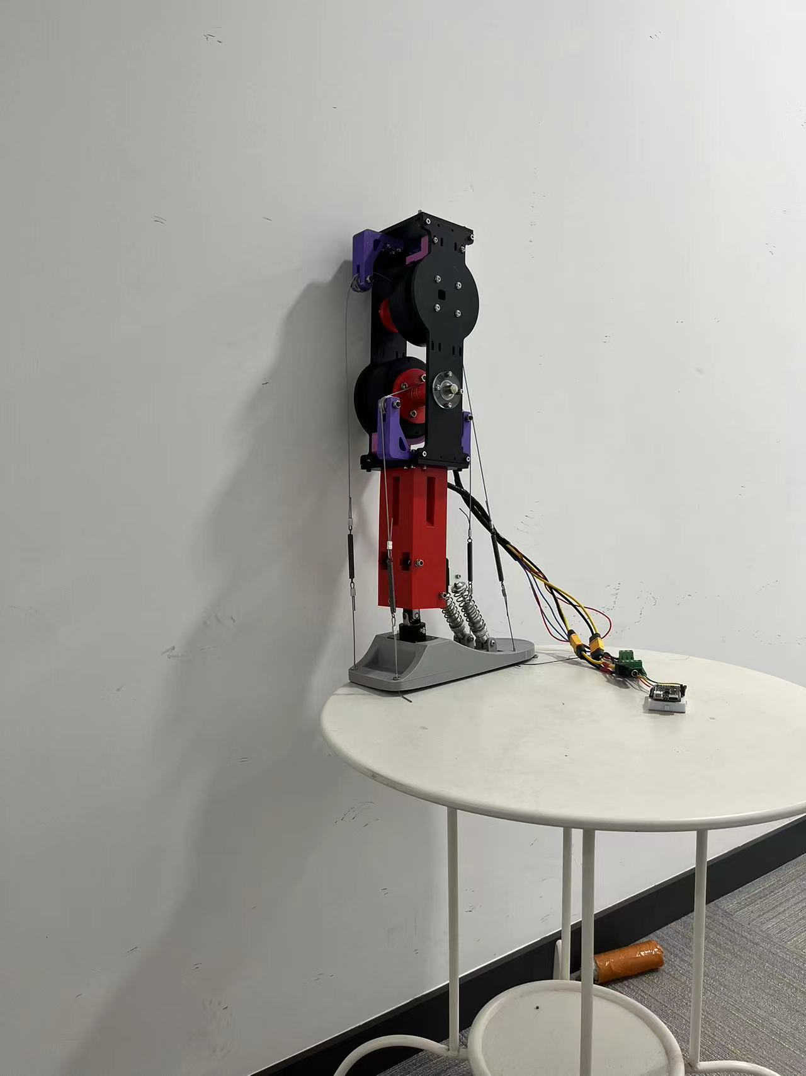
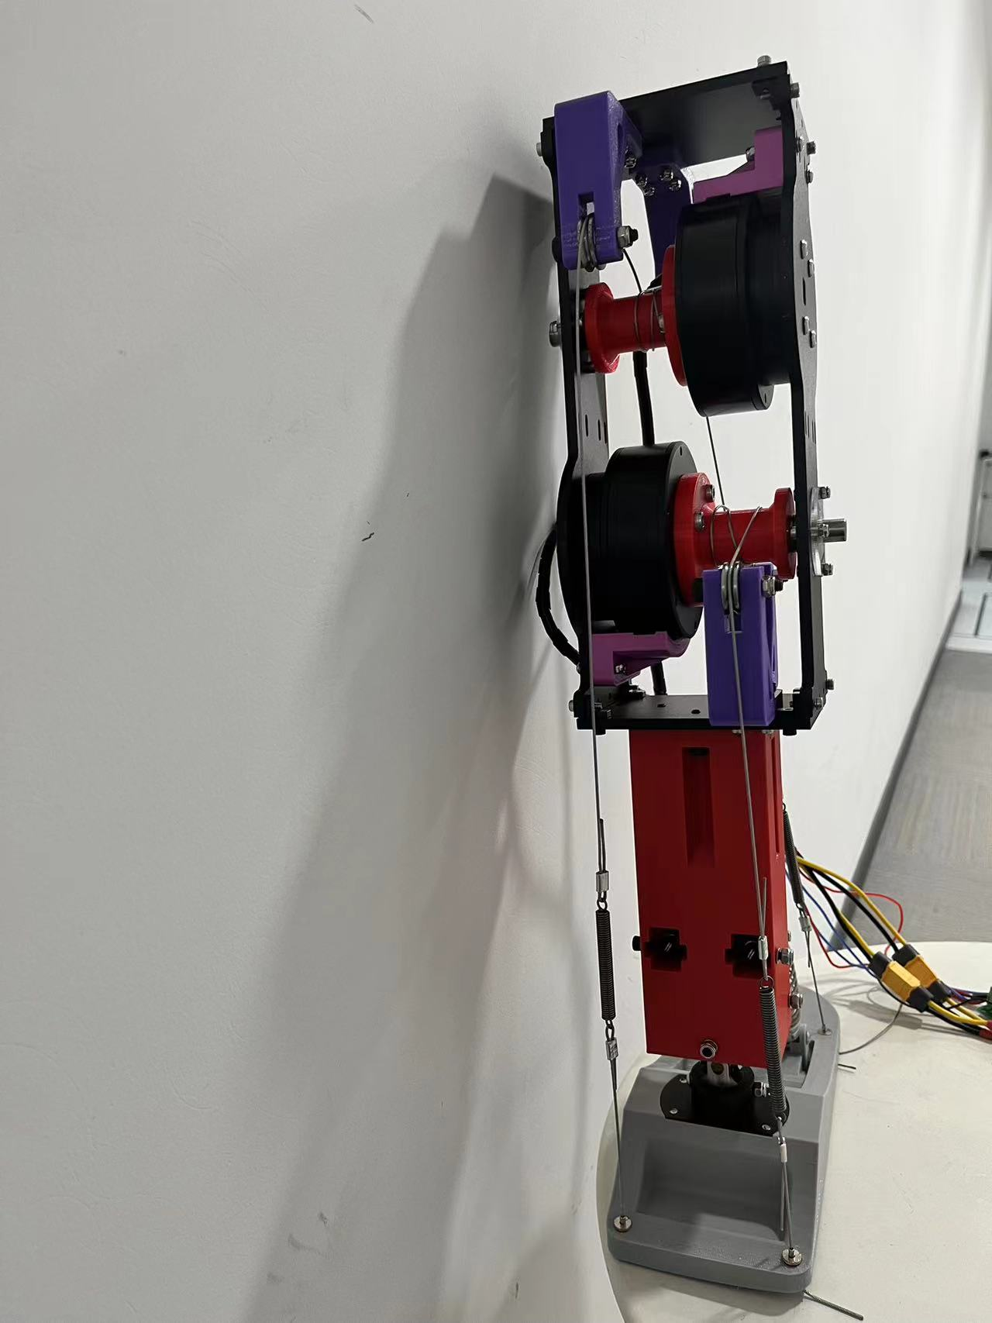
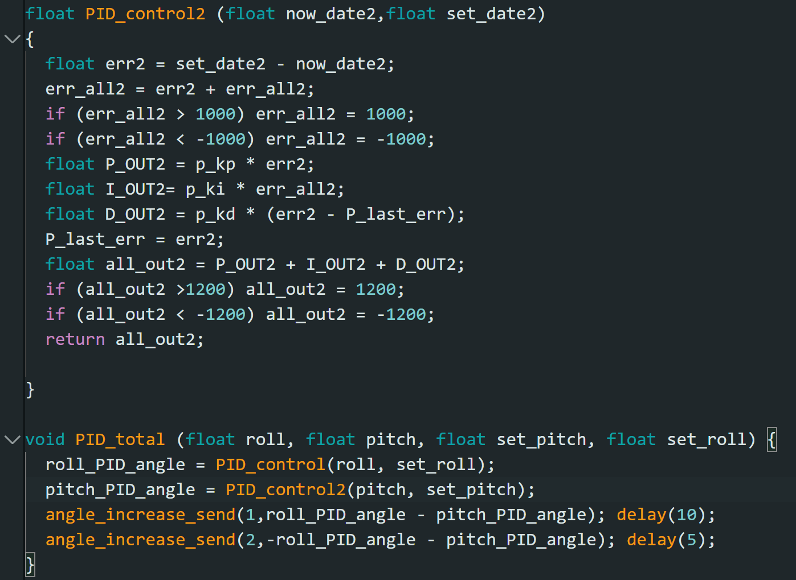
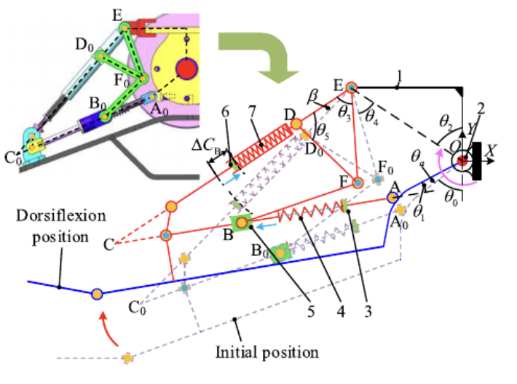
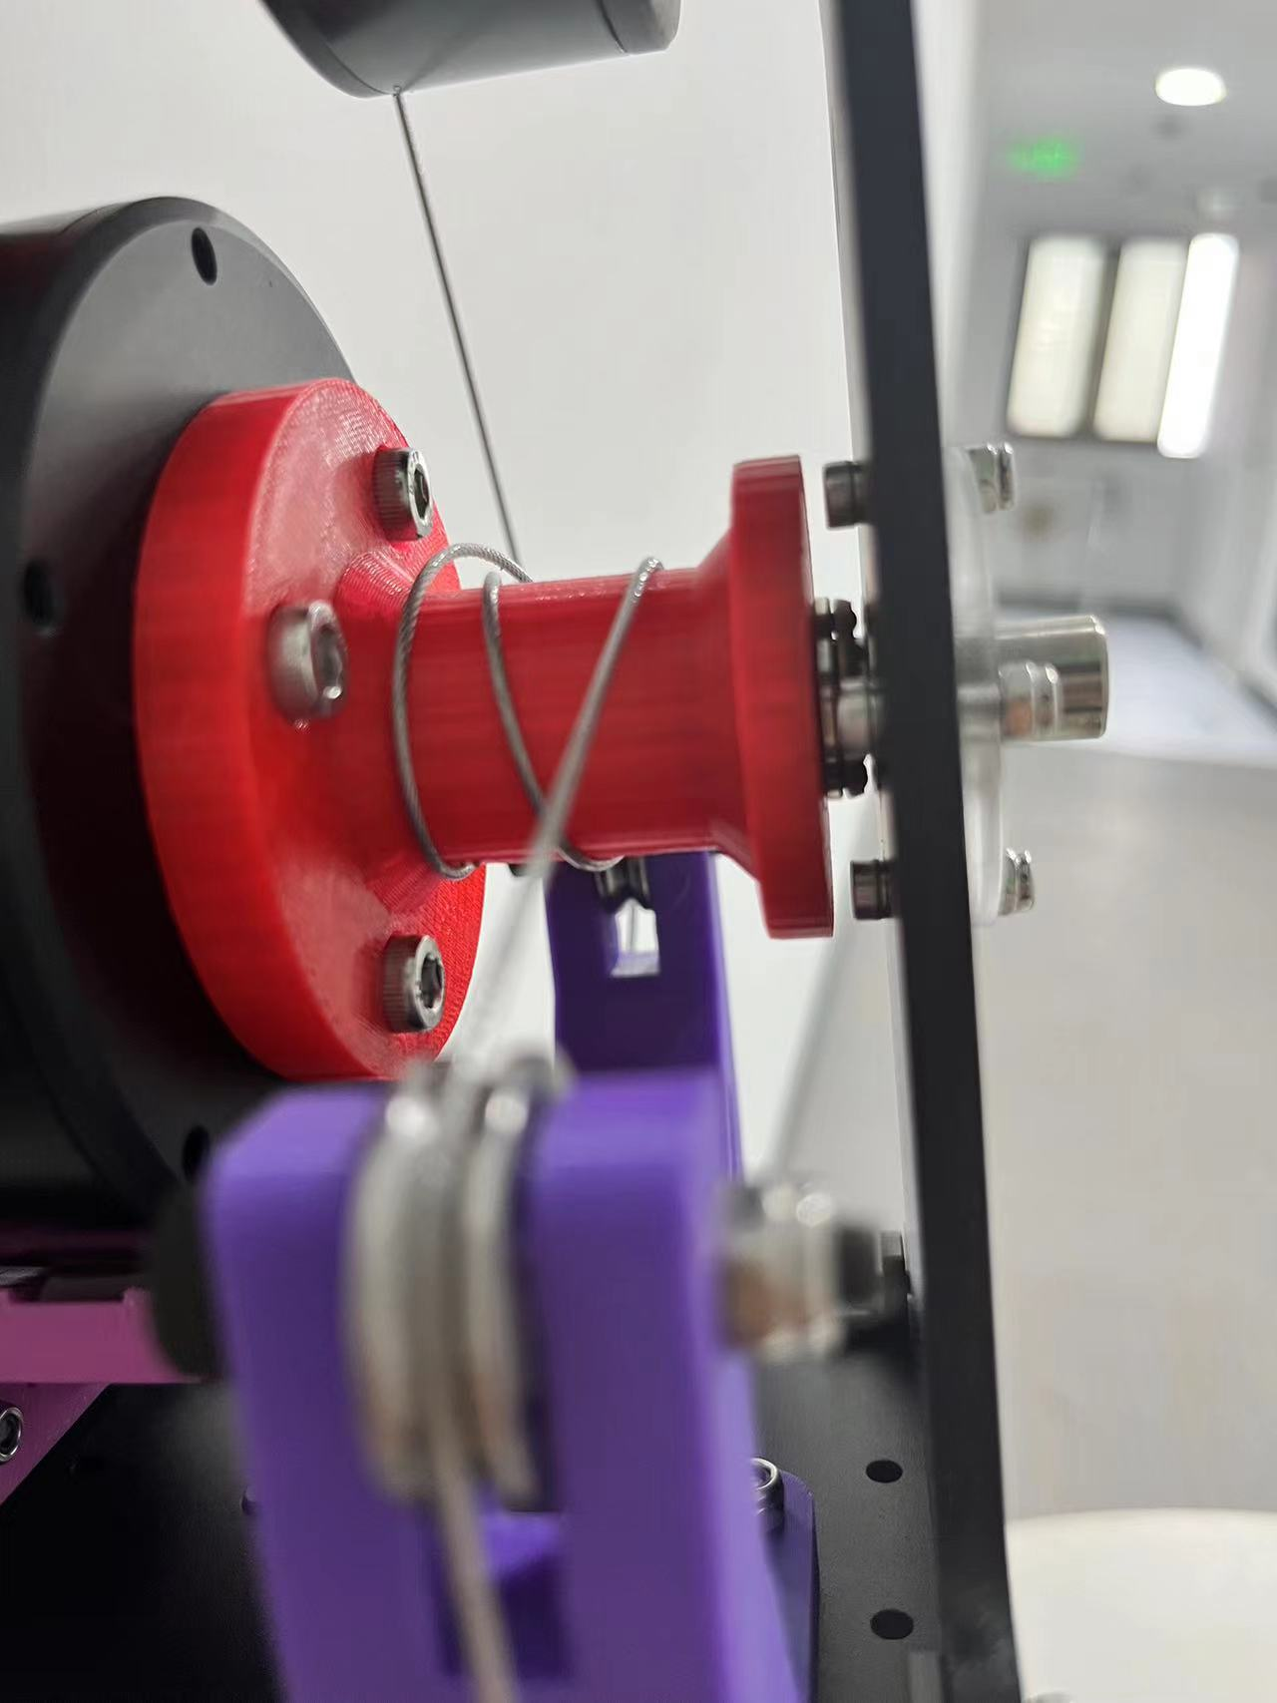
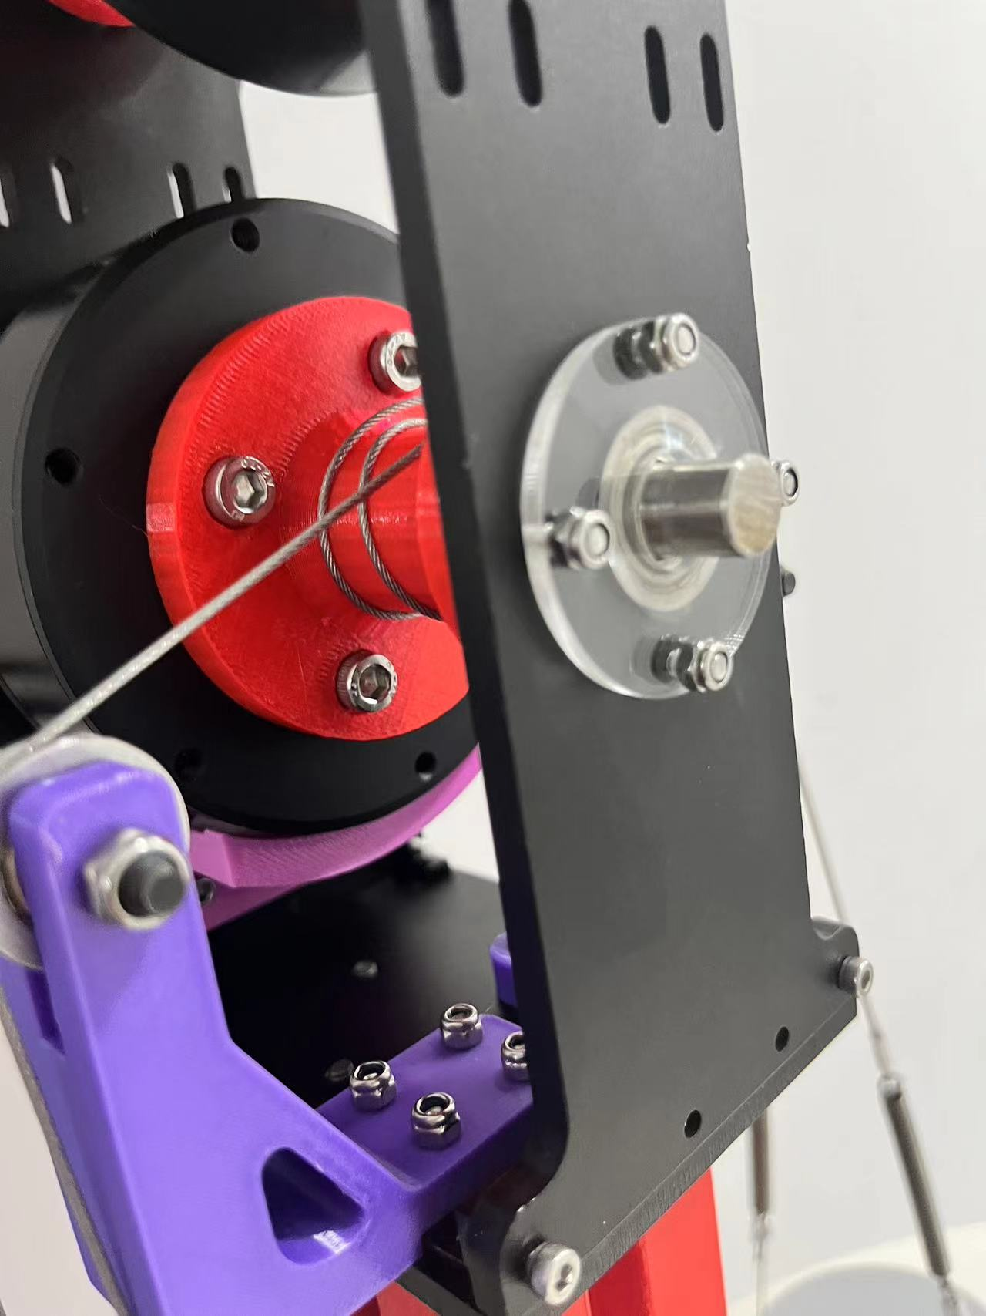
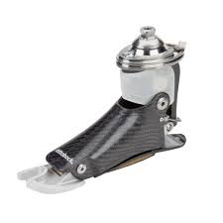
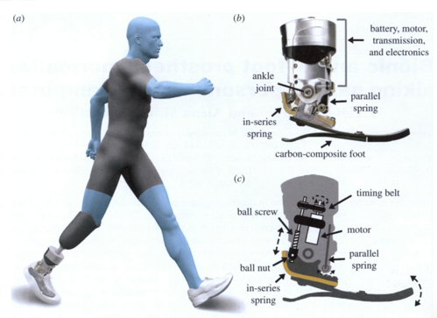
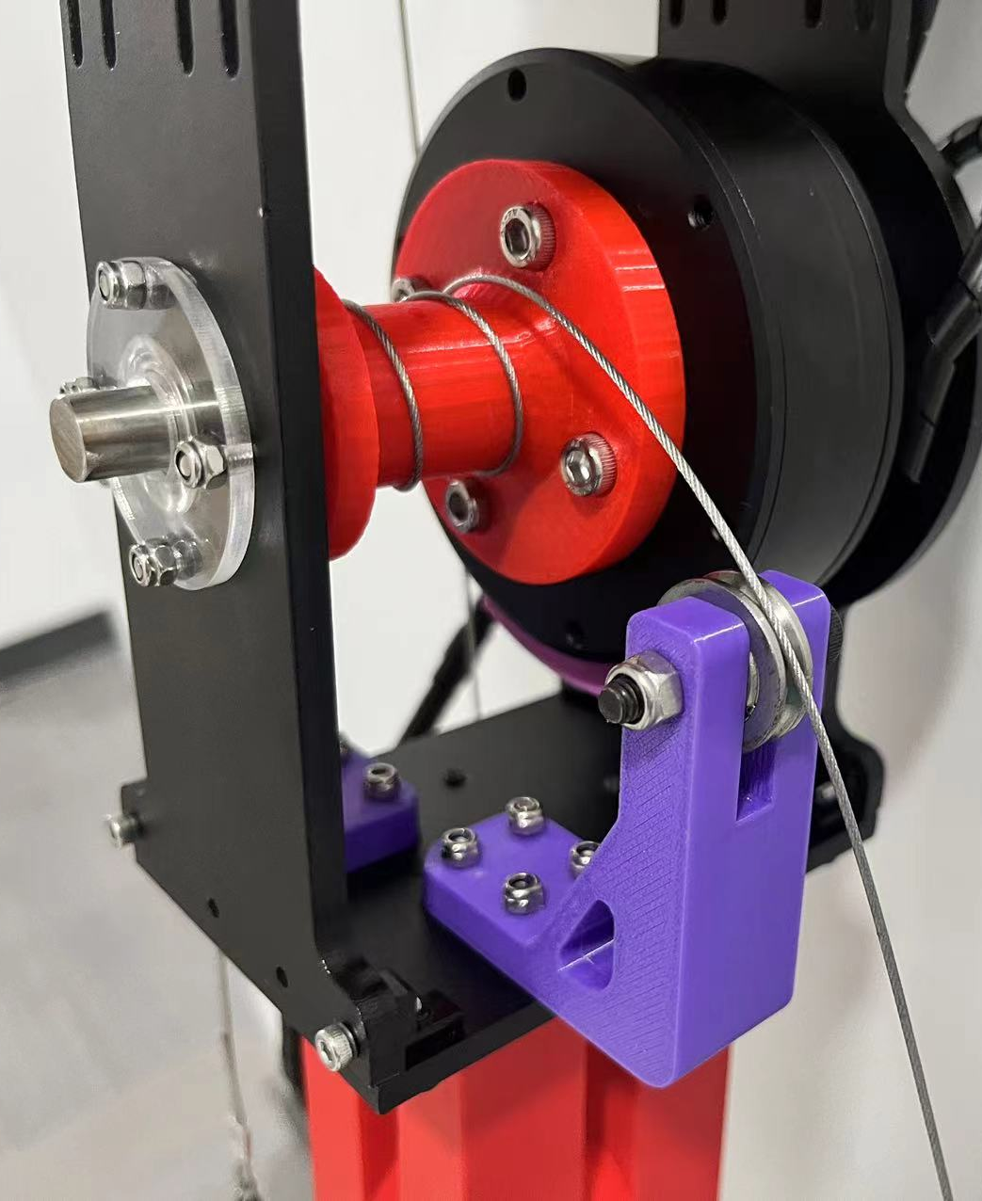
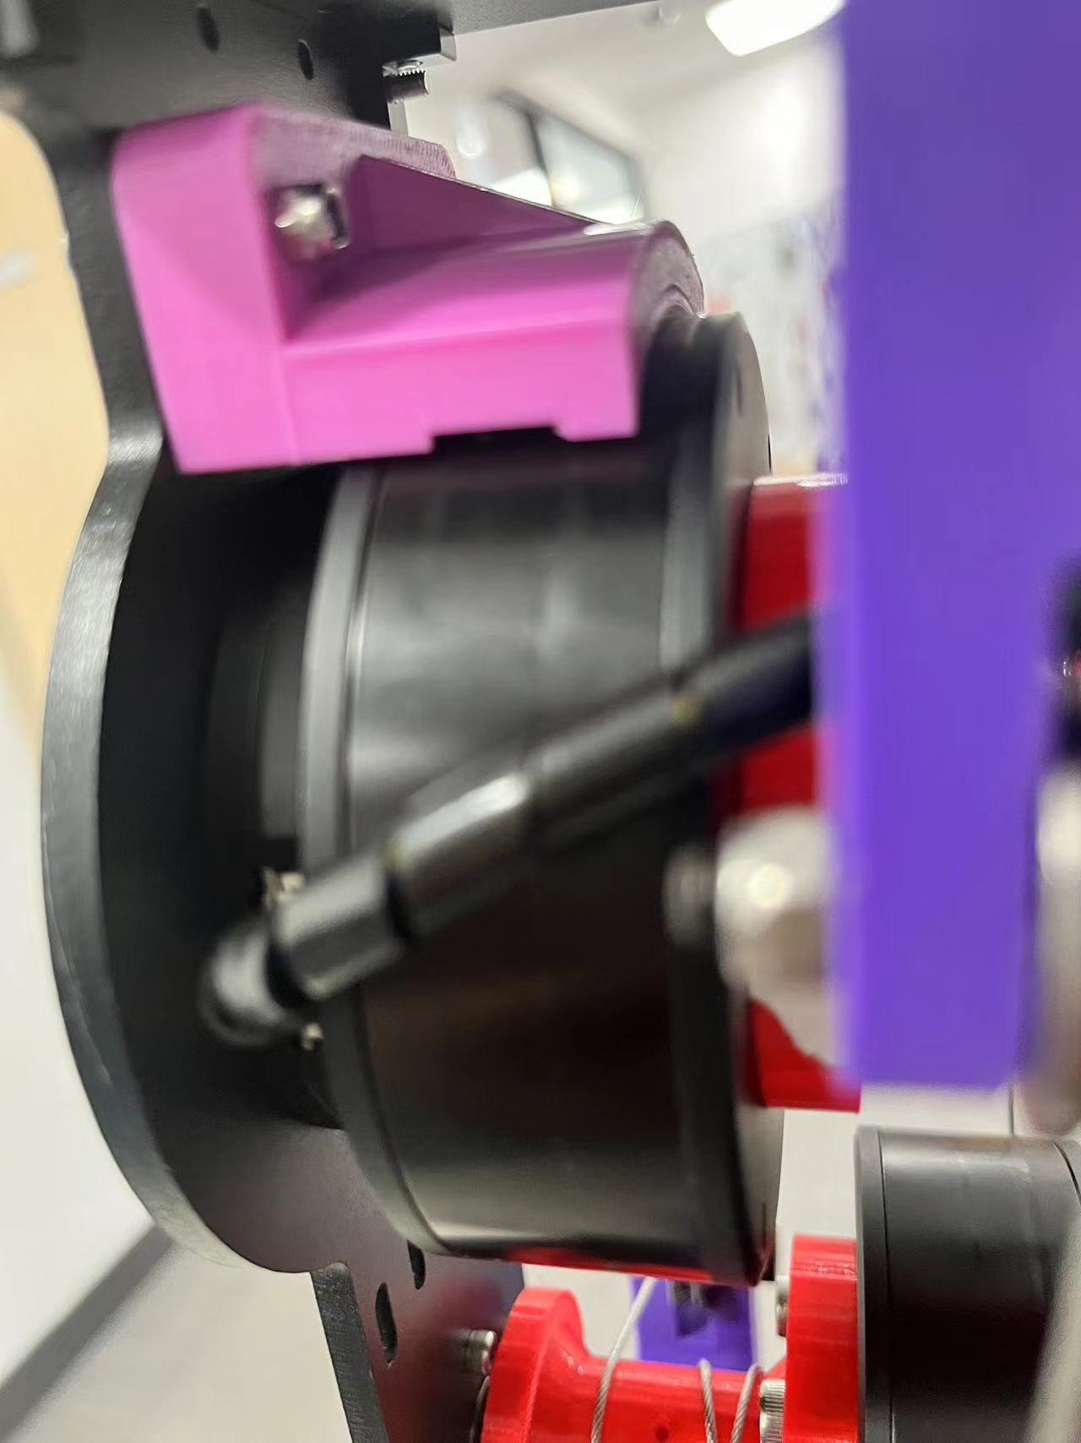
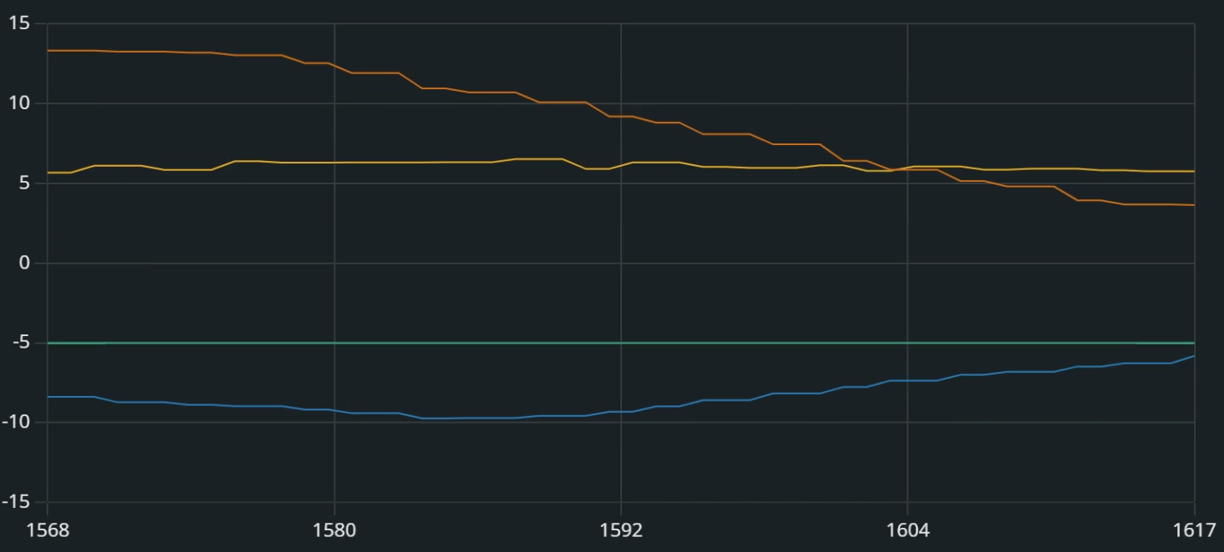
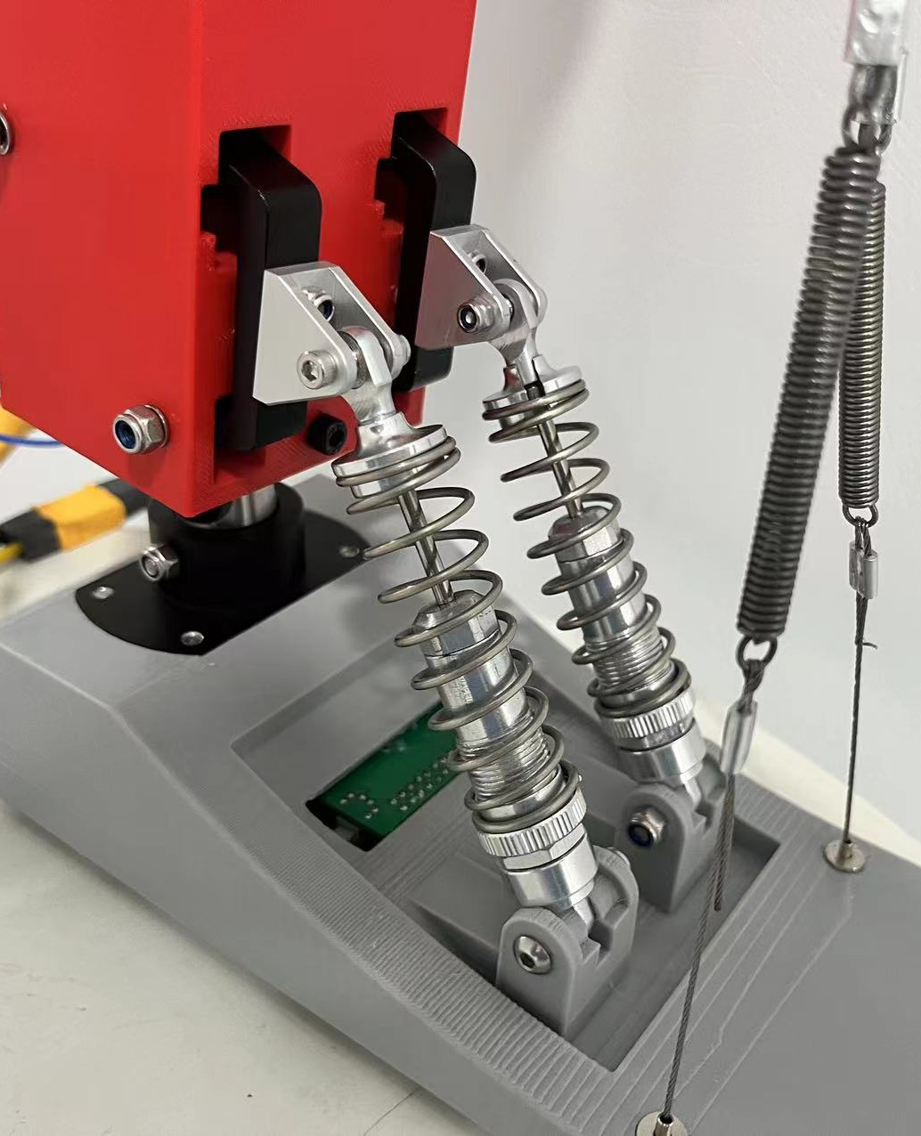
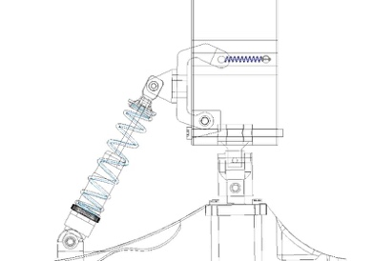
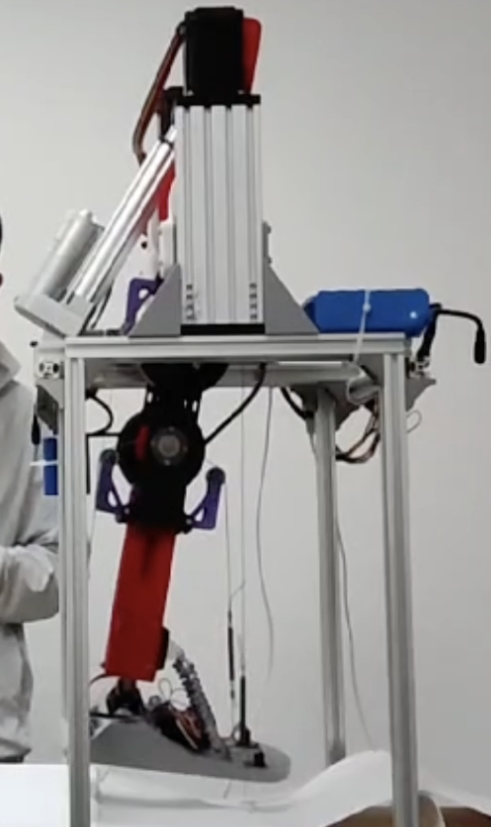
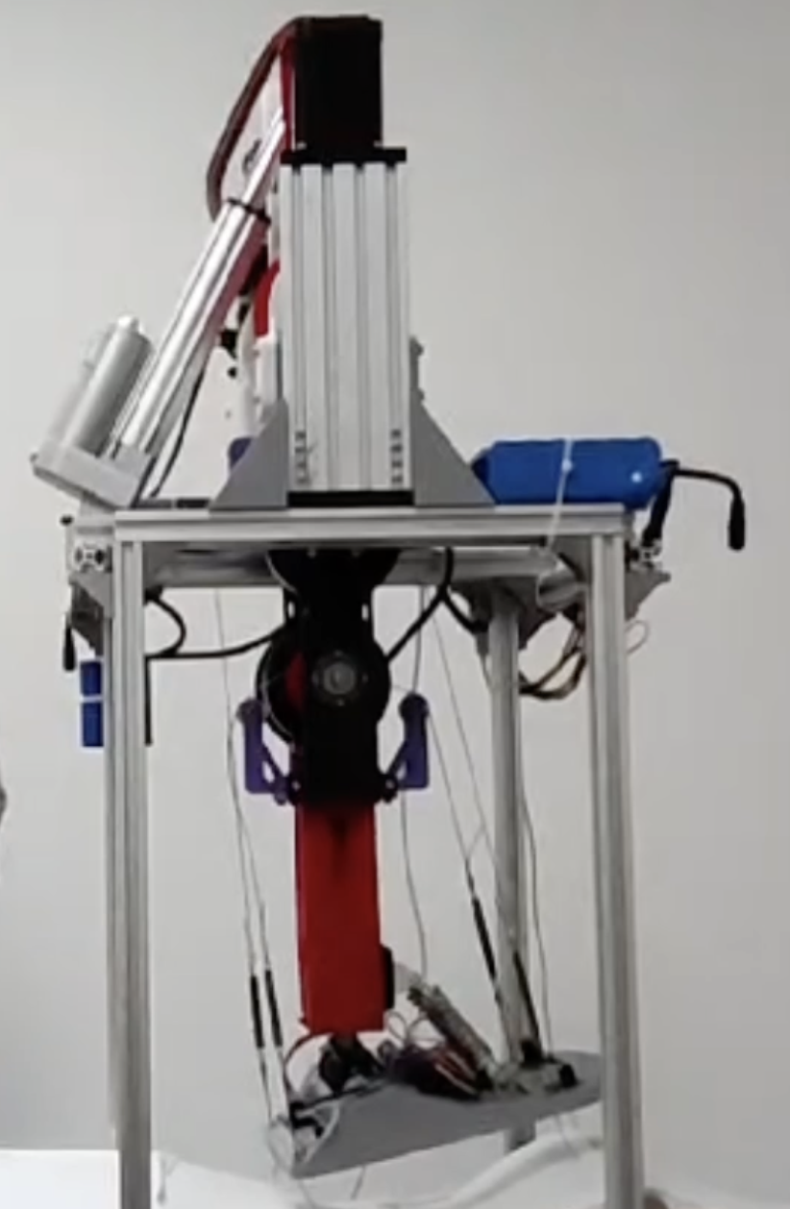
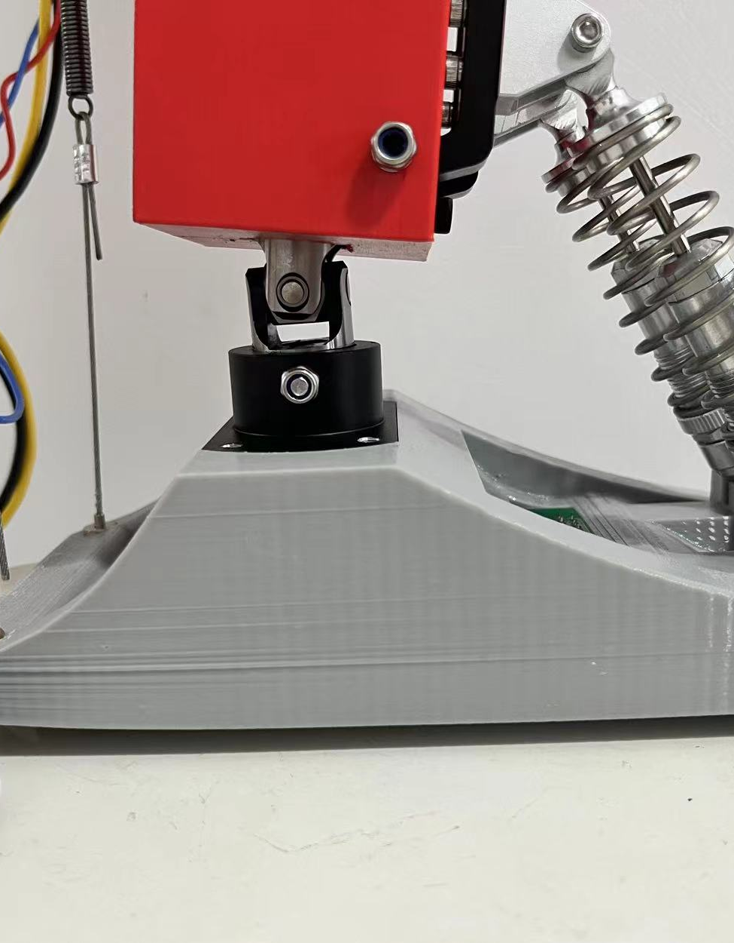
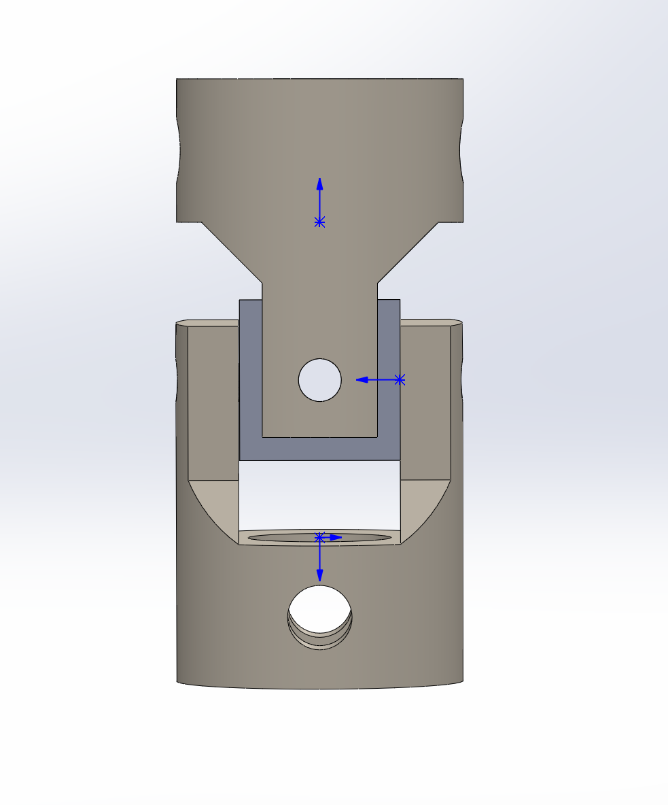
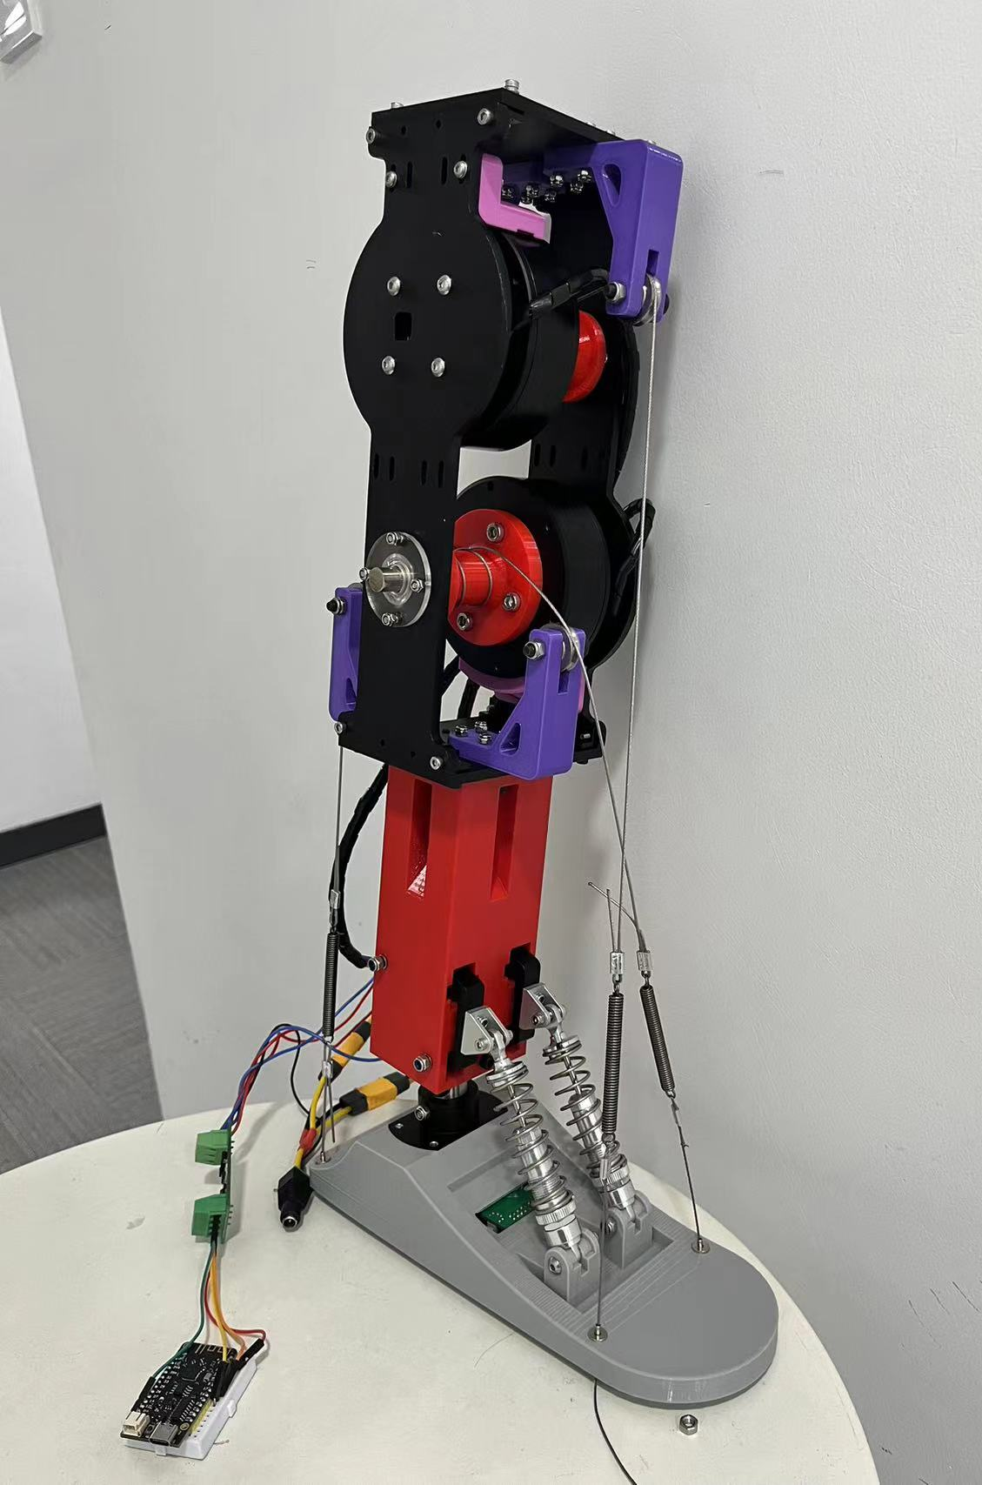
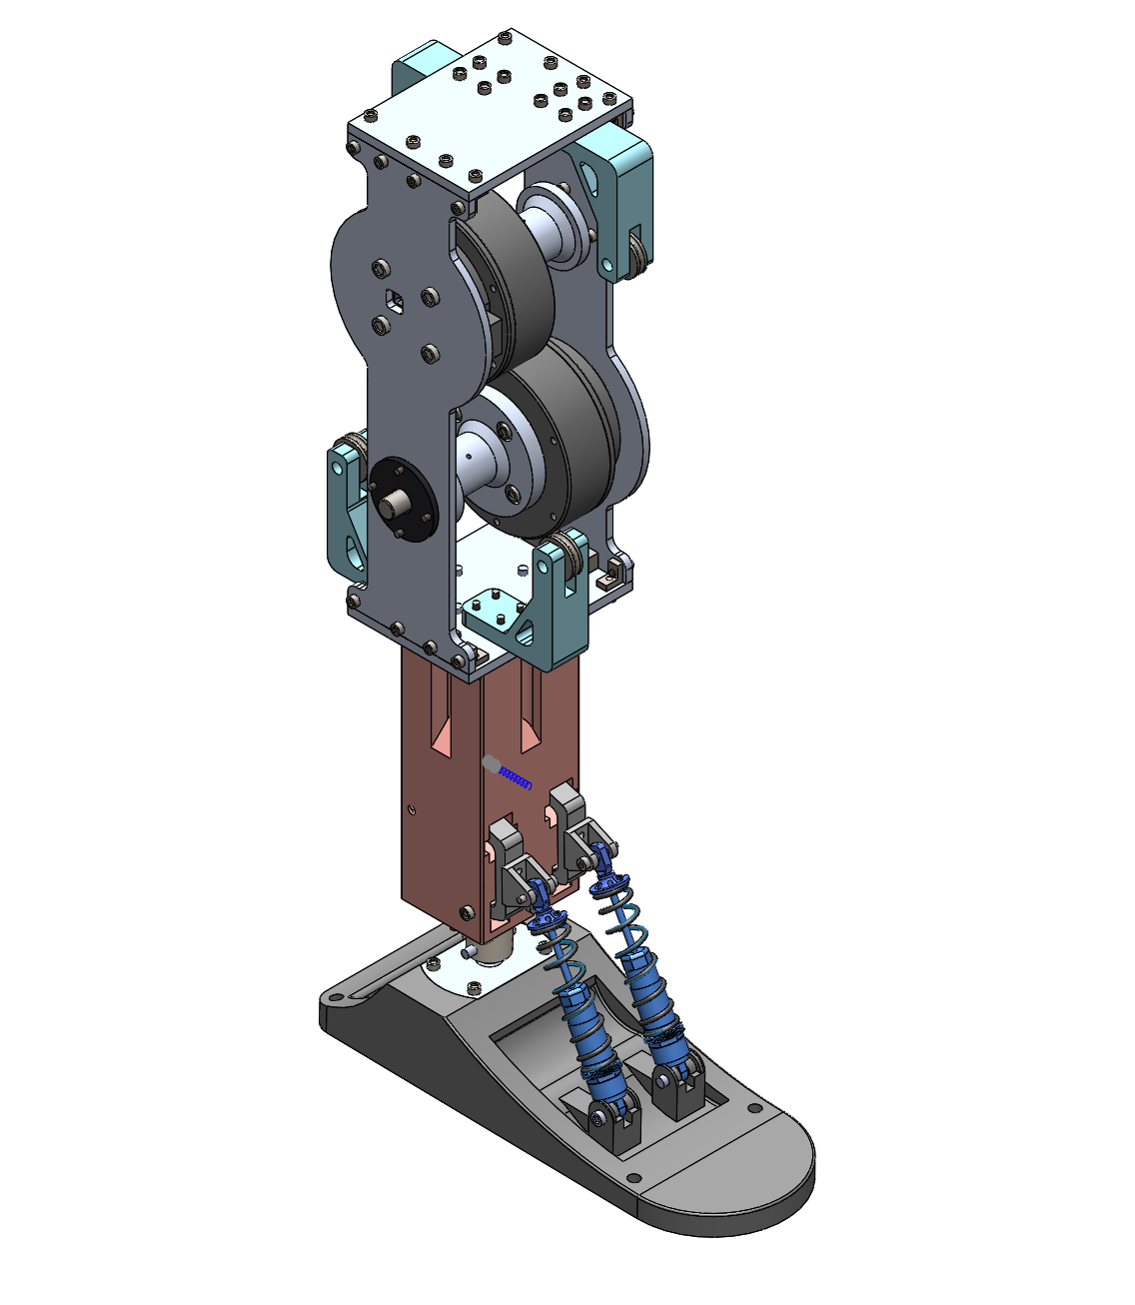
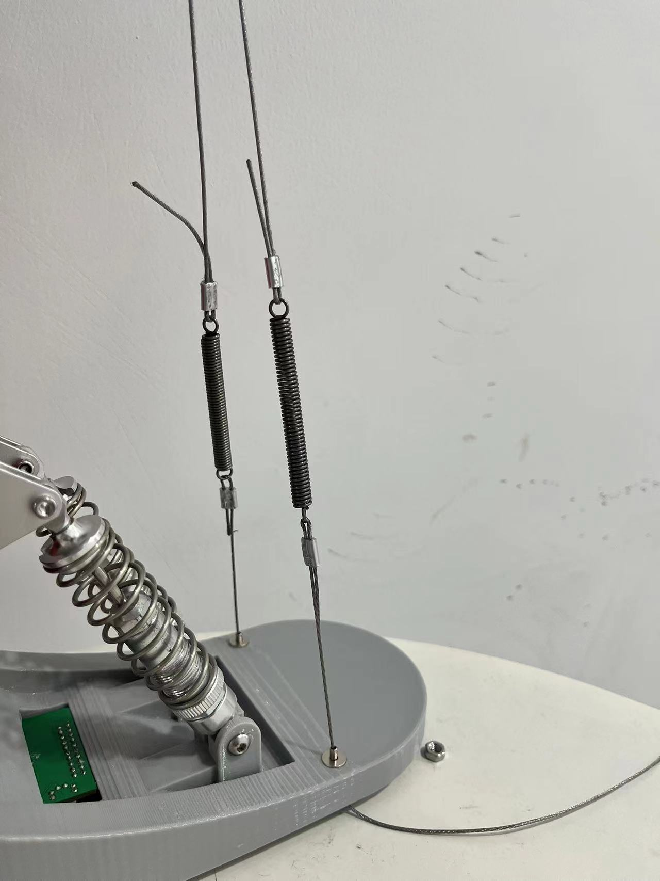
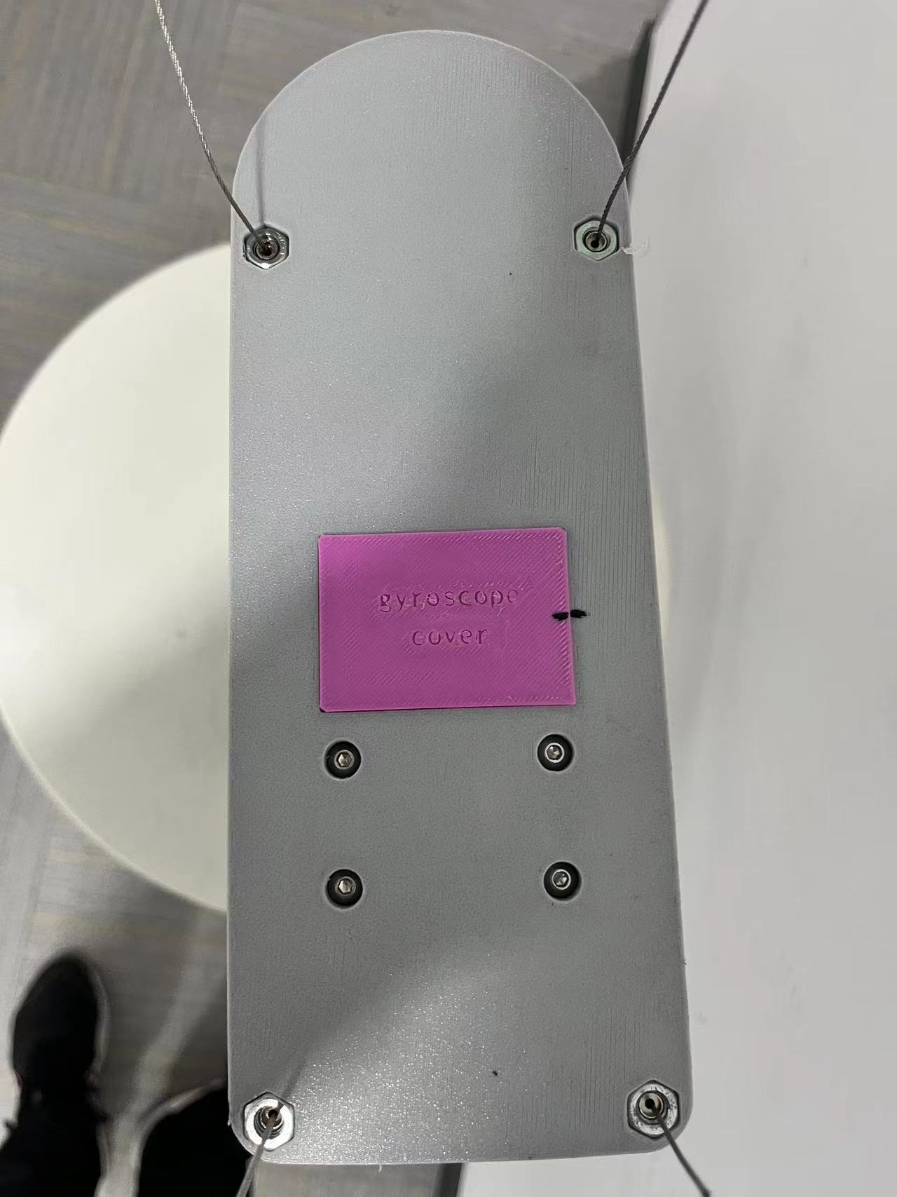
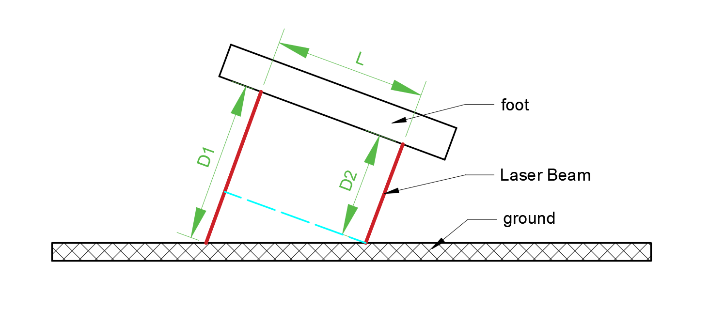
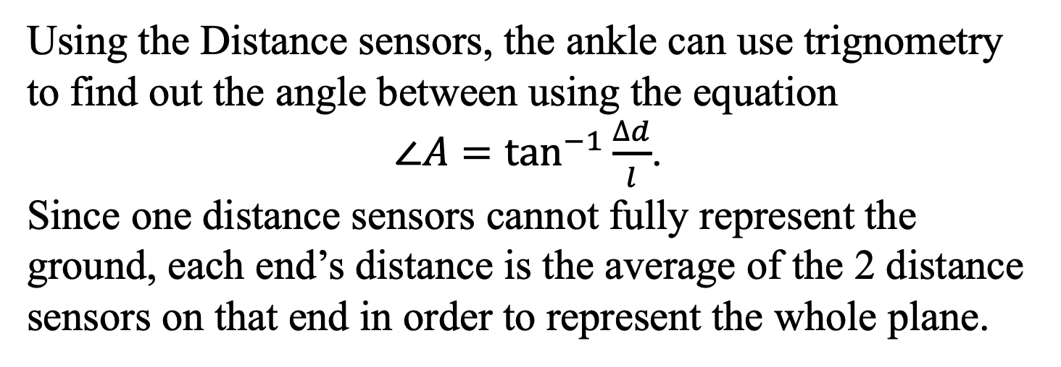
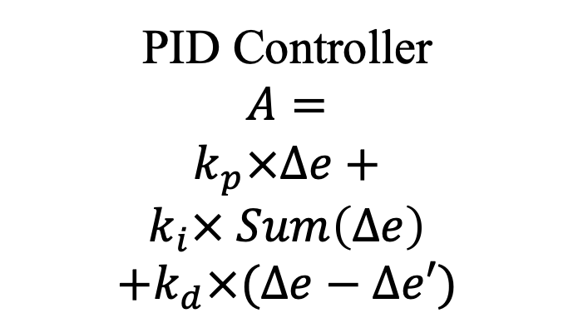
A Self-adaptive Multi-terrain Bionic Ankle
Experiment 1-Ankle’s movement
Shanghai SHSID
This experiment attempts to explore how much can the foot move in the four directions: plantar flexion, dorsiflexion, inversion, and eversion.
Justin Guo
Figure
Solution
Programming
I am trying to make a bionic ankle that can relatively mimic a human ankle, and help disabled people to walk once more.
1. Using Solidworks, I first plan out the whole structure of hardware to check out the plan’s feasibility.
2. Then, I started on building the whole project’s hardware.
The supporting system is carefully considered to be close to an actual adult human lower leg
The motors are attached to axles, along with track rollers and flange bearings to decrease friction and attaching to supporting boards
There are then guide wheels to guide the strings to their designated places and damping to reduce the vibration of the motors.
The spring system contains of two parallel groups each with two springs so that the springs can apply to all directions
The universal joint is connected between the foot and the leg. The parts connecting the universal joint are specially designed to withstand power.
The strings are connected to springs to give it more stretch, and fastened tightly to the ends of the foot, wrapping around on the motors
3. I then build the Arduino setup, using esp32 as the controller, a gyroscope as a sensor, and two motors as the drive force. Esp32 can wirelessly send data to other esp32. This means the gyroscope, which is embedded into the foot, do not need to connect a wire all the way down.
Problem
Figure 20: Angle of Eversion
Figure 21: Angle of Planar Flexion
Robots that focuses on movement have always been a top favorite in the creation of robotics. This started from build wheel robots, that can quickly navigate smooth surfaces, namely human-built pathways. Then it went to building leg-powered robots, which requires a good ankle to navigate the rough, wild terrains.
Background
Figure 5 (left): Bionic Ankle [side view]
Figure 6 (right): Bionic Ankle [back view]
Figure 22: Angle of Inversion
23: Angle of Dorsiflexion
Figure 16: Software Flowchart
Motion | Maximum angle(°)
Dorsiflexion (up) | 24.1
Plantar flexion (down) | 33.7
Inversion (inward) | 21.9
Eversion (outward) | 14.6
Creating a good bionic ankle is challenging:
To achieve the flexibility of a real human ankle
To be able to interact with the ground
To be able to coordinate the system
Most choose to achieve parts of these aspects.
PID Controller
$$A=$$
$$k_{p}×∆e+$$
$$k_{i}× Sum\left(∆e\right)$$
$$+k_{d}×(∆e−∆e′)$$
Figure 7 (left): Motor, Axle, Track rollers
Figure 8 (right): Flange Bearing
Table 1: The maxinum angle that each movement can get
Figure 17: PID controller code
These numbers relatively matches the human’s ankle movements, with the percent accuracy, except dorsiflexion, are around 26%. This means that the ankle can exceed to human ability, and even surprass it.
The programming of the bionic ankle relies on a 2 variable PID control. The four distance sensors will calculate the inclination of the foot relative to the ground. Then, the self adaptive program will separately apply PID controller on the two element. Then, combine the two outcomes and send it to the two motors, letting them increase or decrease their angle.
Figure 1: A Multi-loop Ankle Foot
Figure 2: BiOM’s bionic ankle
Figure 9 (left): Guide wheels
Figure 10 (right): Damping
Innovation
Experiment 2-Adaption to ground
Added inversion and eversion movements
Used a better spring system to mimic human’s ankle function
Created a self-adaptive program that uses a combination of IMU and laser distance sensors to aid walking on uneven ground.
Graph 1: PID control outcome over time
This experiment shows the bionic ankle’s adaptation to the ground. In the two diagram, the block acts like the ground. The foot will follow the ground and move according to the block.
Color | Meaning
Red | Actual pitch
Yellow | Desired pitch
Green | Desired roll
Blue | Actual roll
Figure 11 (left): Spring system [model]
Figure 12 (right):Spring system [transparent]
Angle(°)
Figure 25: After Time slice of adaptation to the ground video
Function
Time interval(ms)
The bionic ankle will use two motors to mimic the movement of a normal human foot. Using the components spring system, universal joint, and motor system, the bionic foot tries to mimic the body part’s function, including
abosorbing shock,
providing power,
providing joints
providing supports
From 1575 ms to 1600 ms, in this 25 ms time period, the PID algorithm reacted quickly to approach their desired pitch value and desired roll value.
Figure 13 (left): Universal Joint [in model]
Figure 14 (right):Universal Joint
Final Product
Figure 24: Before Time slice of adaptation to the ground video
Distance Sensors
The below graph is the values of the experinment. As the block moves, the desired pitch and roll will change, therefore the foot’s pitch and roll will move according to it.
Detecting the ground is one of the important objective in the self-adpative program.
Figure 15 (left): Springs in strings
Figure 16 (right): Foot bottom, with strings binding to it
Graph 1 clone: PID control outcome over time
Color | Meaning
Red | Actual pitch
Yellow | Desired pitch
Green | Desired roll
Blue | Actual roll
Angle(°)
Using the Distance sensors, the ankle can use trignometry to find out the angle between using the equation
$∠A=\tan^{−1}{\frac{∆d}{l}}$.
Since one distance sensors cannot fully represent the ground, each end’s distance is the average of the 2 distance sensors on that end in order to represent the whole plane.
Time interval(ms)
Figure 18: Actual Work
Figure 19: Solidworks Model
This adaption to the ground can help the users tranverse complex terrains and environment.

